Slide 1
BEFORE YOU DO ANYTHING!
Install the Open Sans family of fonts, which is free and can be downloaded here:
http://www.fontsquirrel.com/fonts/open-sans
We make a lot of use of the Open Sans Light font, but you need them all.
To install:
Download the fonts, unzip, and copy them to your font folder. Then quit PowerPoint and reboot your computer. Then check it on the next page.

Slide 2

FONT CHECK!!!
This presentation uses the Open Sans family of fonts, which is free and can be downloaded here:
http://www.fontsquirrel.com/fonts/open-sans
If the left and right look the same it means you have properly installed Open Sans.
Open Sans Light
Open Sans Light
Open Sans
Open Sans
Open Sans Semibold
Open Sans Semibold
Open Sans Bold
Open Sans Bold
If the left looks different, you need to reinstall Open Sans family of fonts, quit PowerPoint and restart

Slide 3

Lunch & Learn Session
3D Printing - Erick Dominguez

Slide 4
What’s 3D Printing?
3D Printing is a process for making a physical object from a 3D model, It brings a digital object into its physical form by adding layer by layer of materials.

Slide 5
How It Works?
There are different types of 3D printers with different technologies that processes many materials in different ways

Slide 6
Printing Technologies

Slide 7
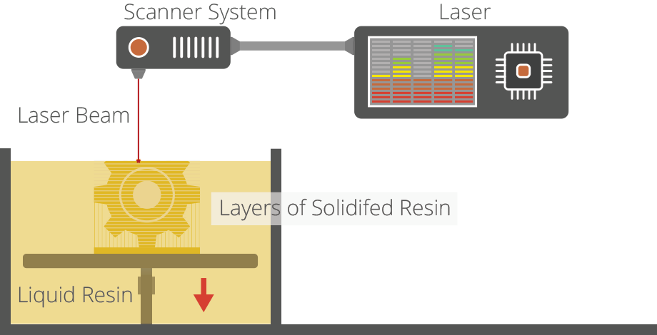
SLA
Stereolithography

Slide 8
Video

Slide 9
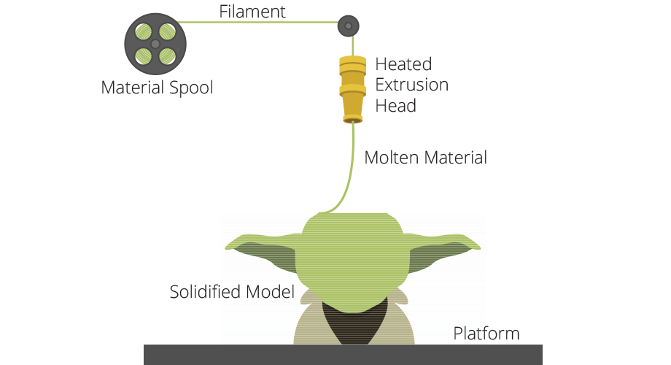
FDM Fused deposition modeling

Slide 10
FDM
Fused deposition modeling
3D Model
Select your 3D model and slice it.
Filament
Plastic material is ingested into the printer
Layer creation
Layer by layer the object is created by placing the melted filament into the printer’s bed
Final object
You obtain your powerful printed model.

Slide 11
Video

Slide 12
Materials

Slide 13
3D Printing Materials
There is now a wide variety of different material types, that are supplied in different states.
Plastics
Metals
Ceramics
Bio Materials
Food
…

Slide 14
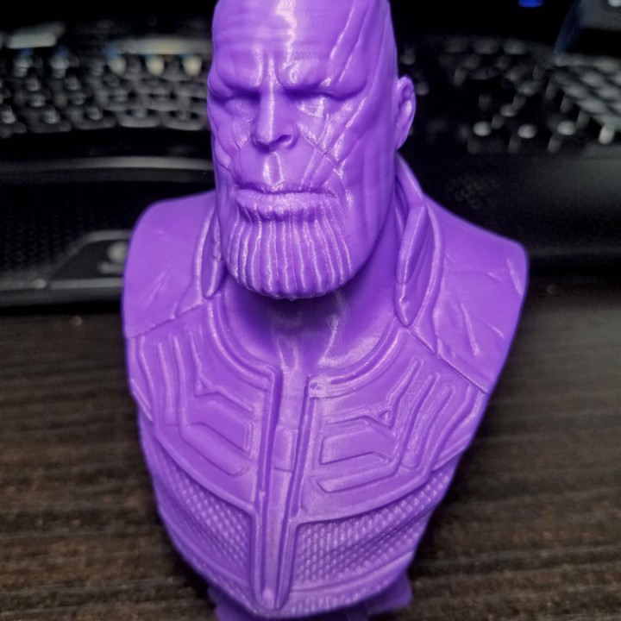
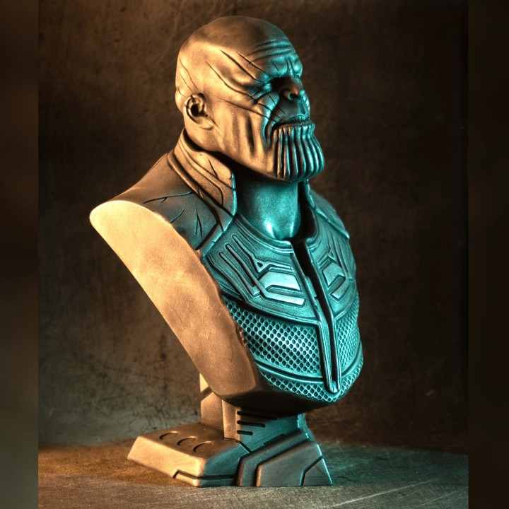
Plastic
ABS strong plastic and comes in a wide range of colors
PLA is a bio-degradable plastic

Slide 15
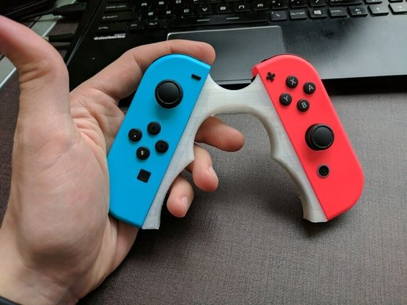
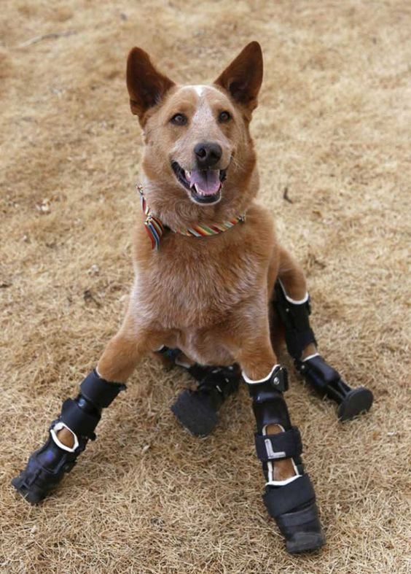
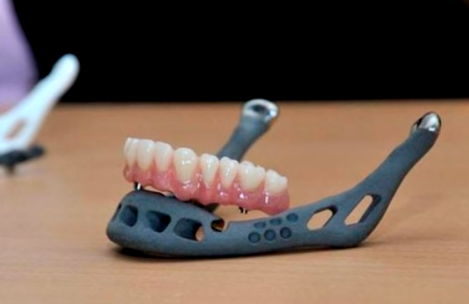
Plastic

Slide 16
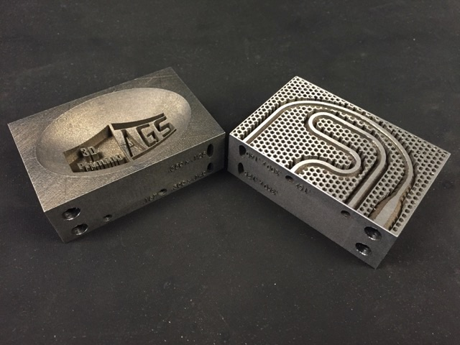
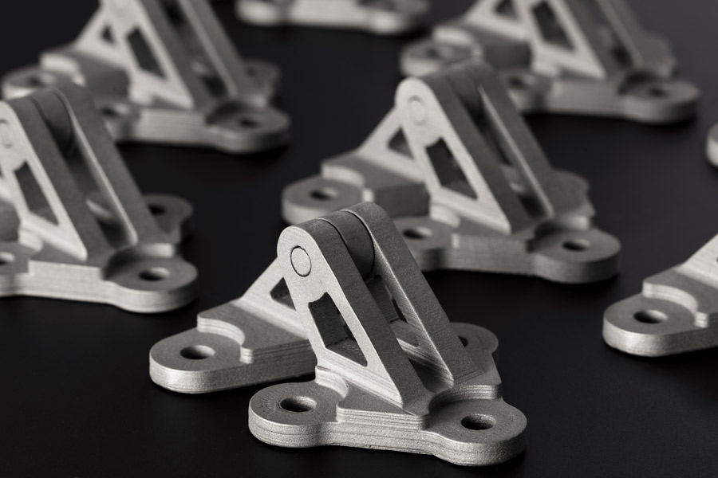
Metals

Slide 17
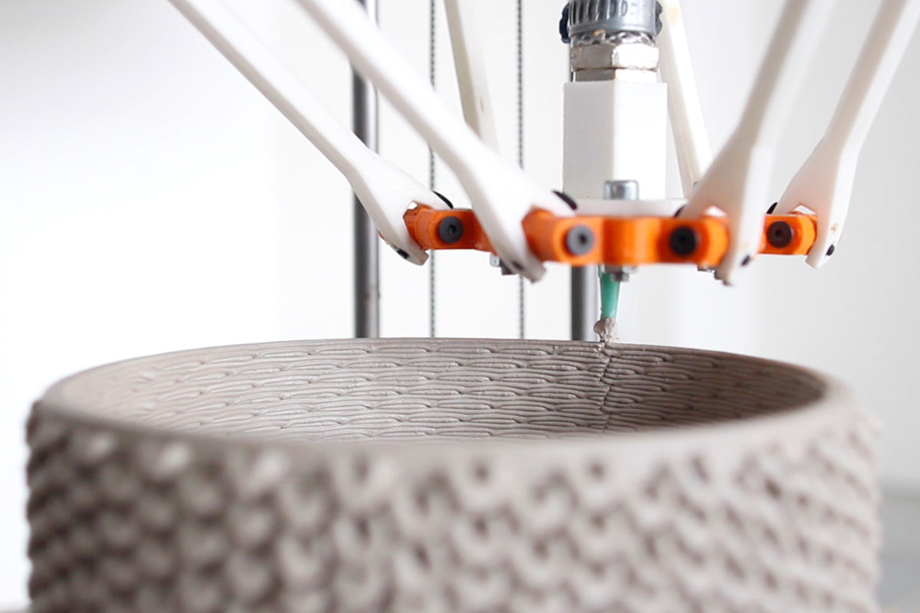
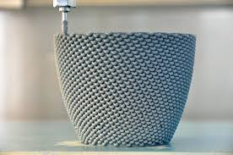
Ceramics

Slide 18
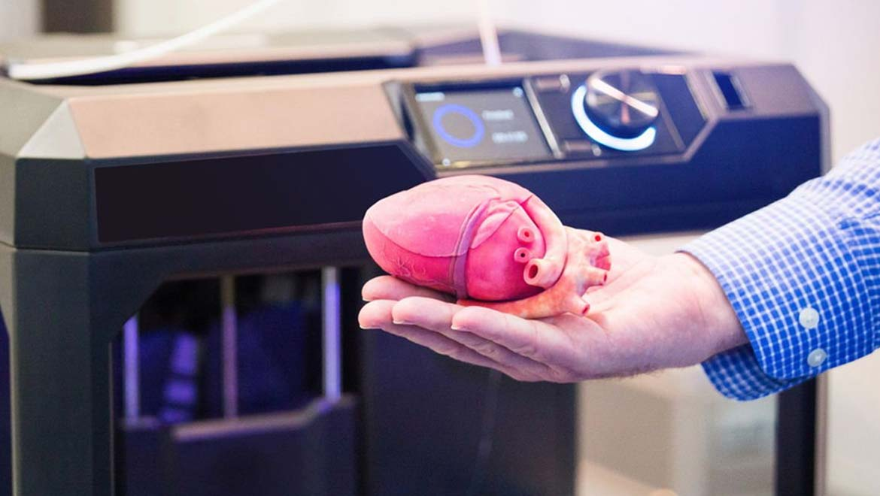
Bio Materials

Slide 19
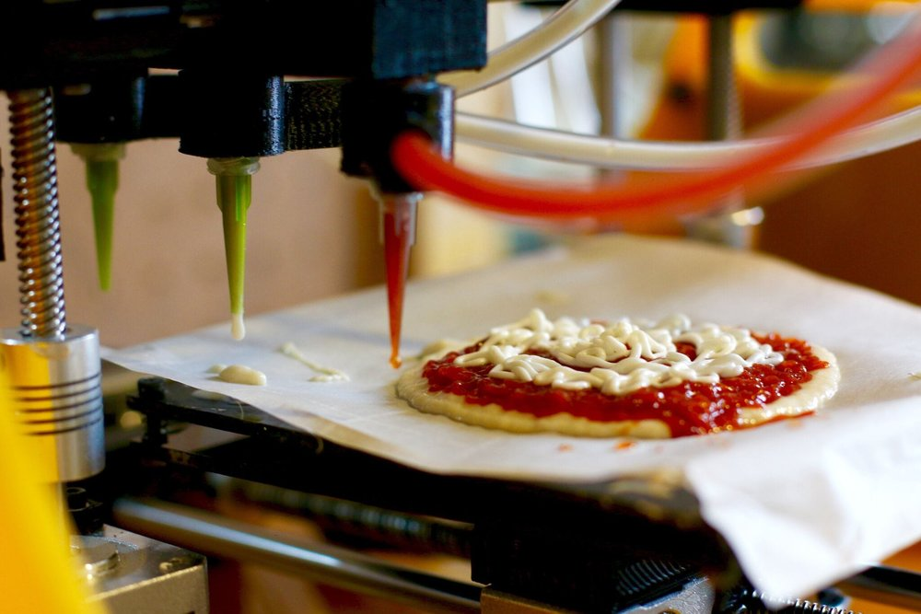
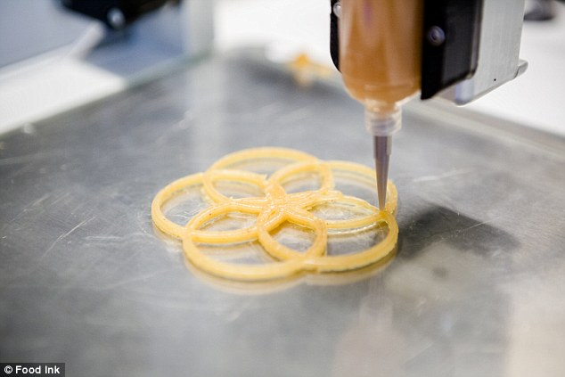
Food

Slide 20
What do I need to print?
3D Printing is a process for making a physical object from a 3D model, It brings a digital object into its physical form by adding layer by layer of materials.

Slide 21
TOP 10 3d prints

